Slide 1
Transaction Management & Concurrency

Slide 2
Objectives
Function and importance of transactions.
Properties of transactions.
Concurrency Control
  Meaning of serializability.

Slide 3
Transaction
  Transaction
  Action, or series of actions, carried out by user or application, which reads or updates contents of database.
Logical unit of work on the database.
Application program is series of transactions
Transforms database from one consistent state to another, although consistency may be violated during transaction.

Slide 4
Transaction
Can have one of two outcomes:
  Success - transaction commits and database reaches a new consistent state.
  Failure - transaction aborts, and database must be restored to consistent state before it started. Such a transaction is rolled back or undone.
Committed transaction cannot be aborted.
Aborted transaction that is rolled back can be restarted later.

Slide 5
Properties of Transactions
Four basic (ACID) properties of a transaction are:
Atomicity ‘All or nothing’ property.
refers to the fact that a transaction is treated as a unit of operation. Therefore, either all the transaction’s actions are completed, or none of them are.
Consistency Must transform database from one consistent state to another.
The consistency of a transaction is simply its correctness.

Slide 6
Isolation
Requires each transaction to see a consistent database at all times.
Partial effects of incomplete transactions should not be visible to other transactions.
Durability Effects of a committed transaction are permanent and must not be lost because of later failure.

Slide 7
Concurrency Control
Process of managing simultaneous operations on the database without having them interfere with one another.
Prevents interference when two or more users are accessing database simultaneously and at least one is updating data.
Although two transactions may be correct in themselves, interleaving of operations may produce an incorrect result.

Slide 8
Need for Concurrency Control
Three examples of potential problems caused by concurrency:
  Lost update problem.
  Uncommitted dependency problem.
  Inconsistent analysis problem.

Slide 9
Lost Update Problem
Successfully completed update is overridden by another user.
T₁ withdrawing £10 from an account with bal_{x}, initially £100.
T₂ depositing £100 into same account.
Serially, final balance would be £190.

Slide 10
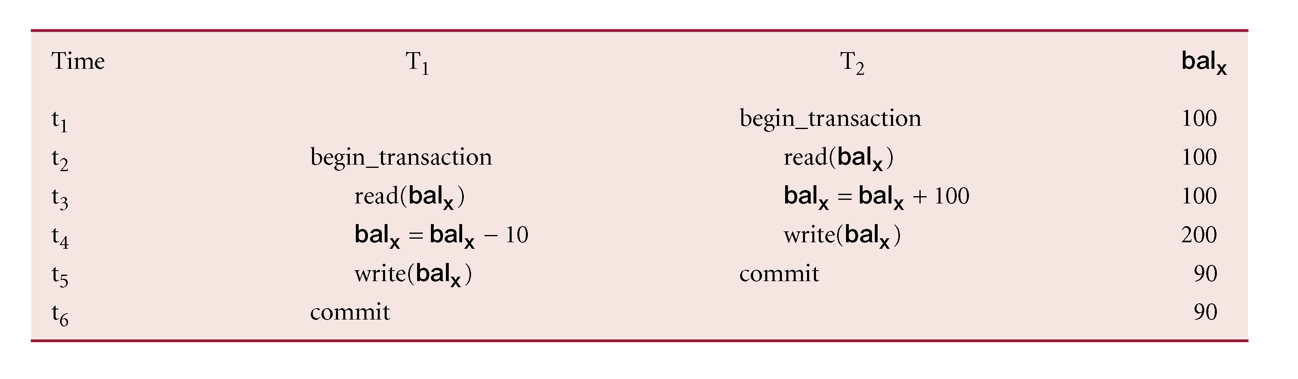
Lost Update Problem
Loss of T₂’s update avoided by preventing T₁ from reading bal_{x} until after update.

Slide 11
Uncommitted Dependency Problem
Occurs when one transaction can see intermediate results of another transaction before it has committed.
T₄ updates bal_{x} to £200 but it aborts, so bal_{x} should be back at original value of £100.
T₃ has read new value of bal_{x} (£200) and uses value as basis of £10 reduction, giving a new balance of £190, instead of £90.

Slide 12
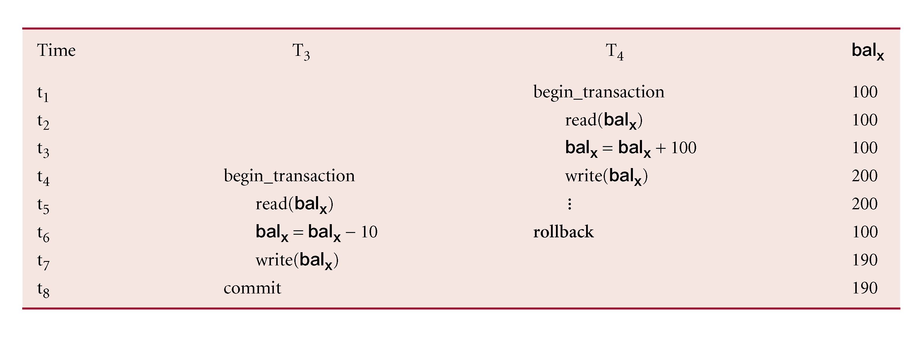
Uncommitted Dependency Problem
Problem avoided by preventing T₃ from reading bal_{x} until after T₄ commits or aborts.

Slide 13
Inconsistent Analysis Problem
Occurs when transaction reads several values but second transaction updates some of them during execution of first.
Sometimes referred to as dirty read or unrepeatable read.
T₆ is totaling balances of account x (£100), account y (£50), and account z (£25).
Meantime, T₅ has transferred £10 from bal_{x} to bal_{z}, so T₆ now has wrong result (£10 too high).

Slide 14
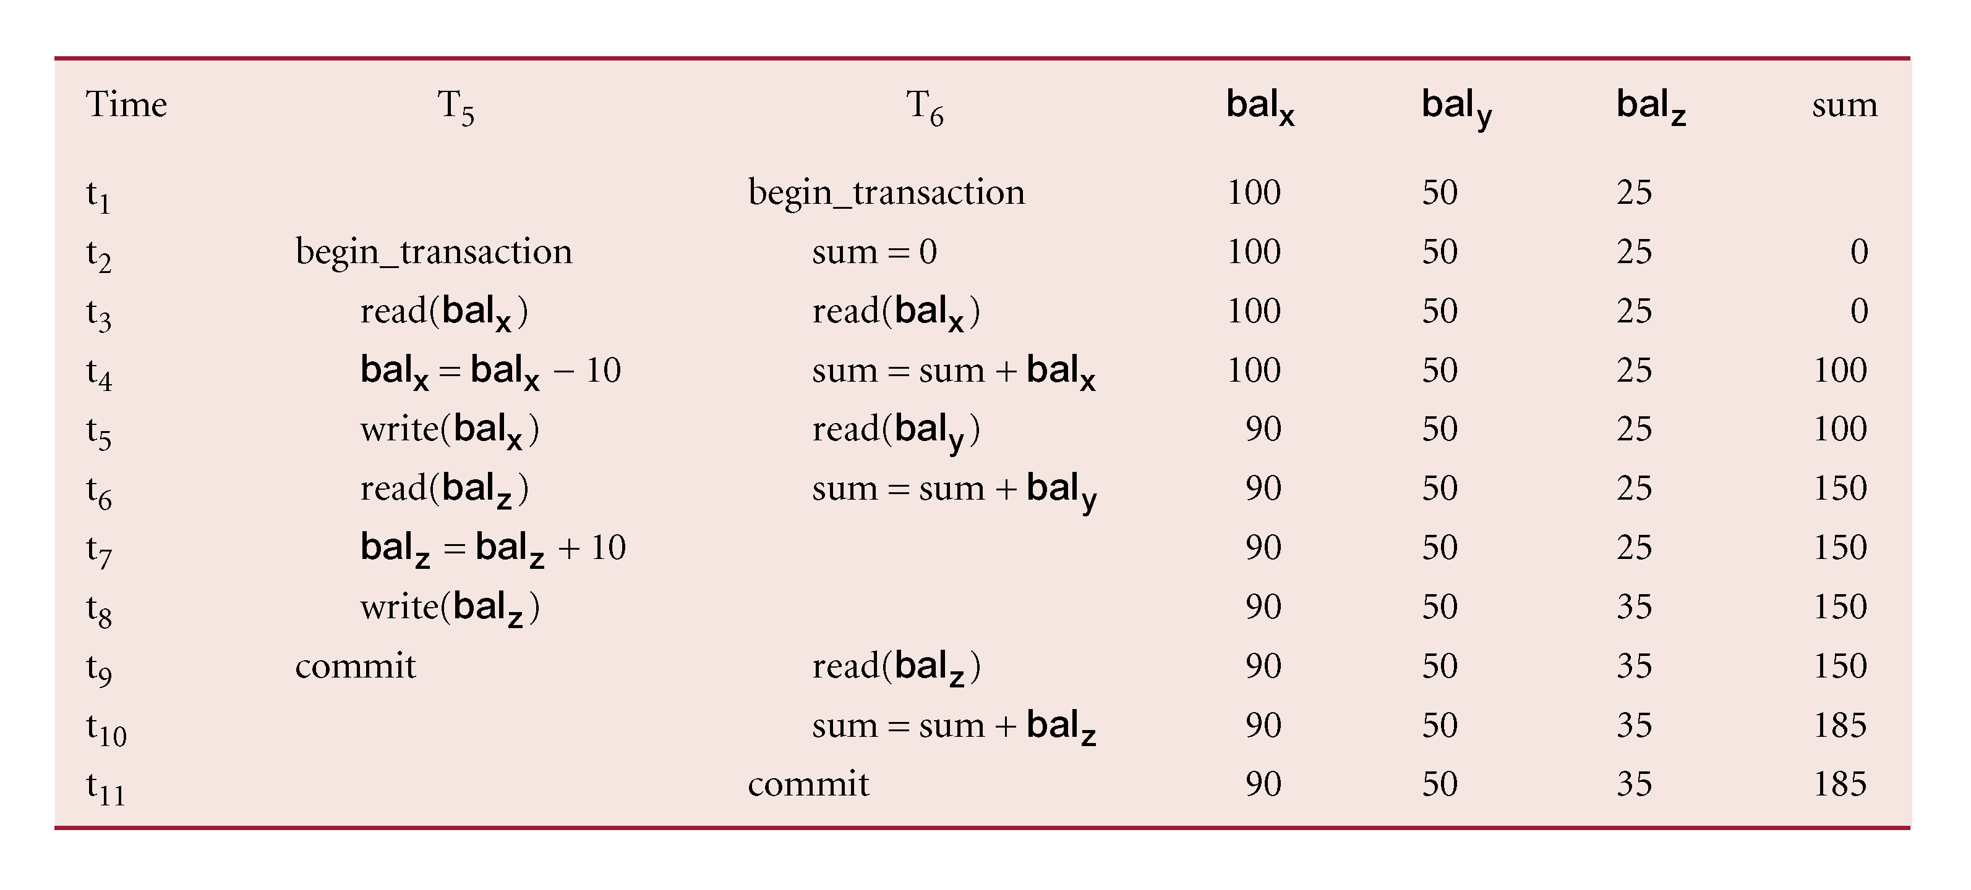
Inconsistent Analysis Problem
Problem avoided by preventing T₆ from reading bal_{x} and bal_{z} until after T₅ completed updates.

Slide 15
Serializability
Objective of a concurrency control protocol is to schedule transactions in such a way as to avoid any interference.
Could run transactions serially, but this limits degree of concurrency or parallelism in system.
Serializability identifies those executions of transactions guaranteed to ensure consistency.

Slide 16
Serializability
  Schedule
  Sequence of reads/writes by set of concurrent transactions.
  Serial Schedule
  Schedule where operations of each transaction are executed consecutively without any interleaved operations from other transactions.
No guarantee that results of all serial executions of a given set of transactions will be identical.

Slide 17
Nonserial Schedule
Schedule where operations from set of concurrent transactions are interleaved.
Objective of serializability is to find nonserial schedules that allow transactions to execute concurrently without interfering with one another.
In other words, want to find nonserial schedules that are equivalent to some serial schedule. Such a schedule is called serializable.

Slide 18
Serializability
In serializability, ordering of read/writes is important:
(a) If two transactions only read a data item, they do not conflict and order is not important.
(b) If two transactions either read or write completely separate data items, they do not conflict and order is not important.
(c) If one transaction writes a data item and another reads or writes same data item, order of execution is important.

Slide 19
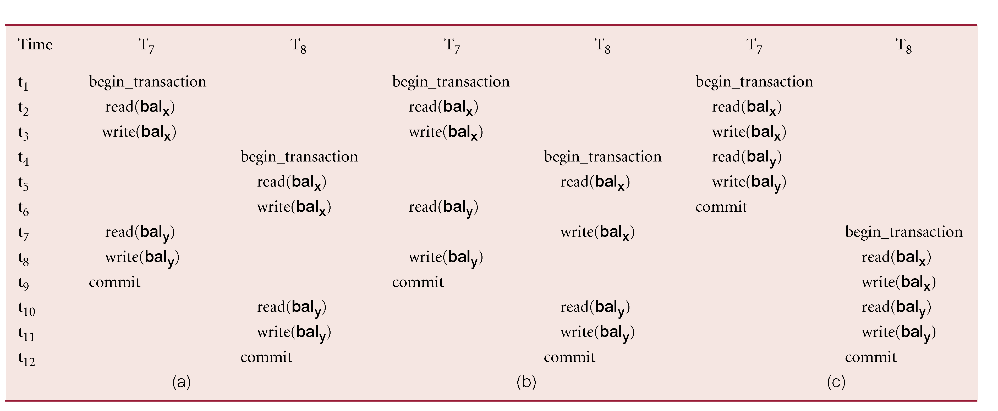
Example of Conflict Serializability

Slide 20
Concurrency Control Techniques
Two basic concurrency control techniques:
  Locking,
  Timestamping.

Slide 21
Timestamping
Transactions ordered globally so that older transactions, transactions with smaller timestamps, get priority in the event of conflict.
Conflict is resolved by rolling back and restarting transaction.
No locks so no deadlock.

Slide 22
Timestamping
  Timestamp
  A unique identifier created by DBMS that indicates relative starting time of a transaction.
Can be generated by using system clock at time transaction started, or by incrementing a logical counter every time a new transaction starts.

